Slide 1


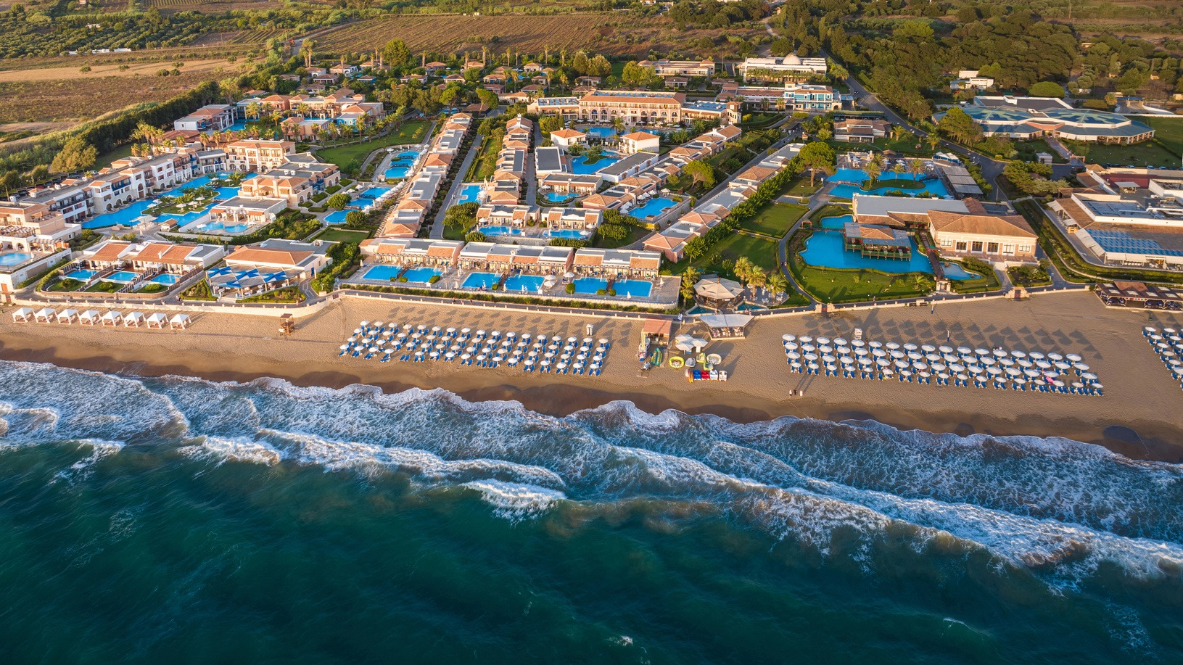



IFMA Executive Committee Meeting | 9 September 2026
IFMA Youth World
Championships 2026
Olympia, Greece
6–16 November 2026
A world-class youth championship where Muaythai, Greek hospitality and Olympic heritage come together.
One Championship. One Resort. One Muaythai Family.

Slide 2

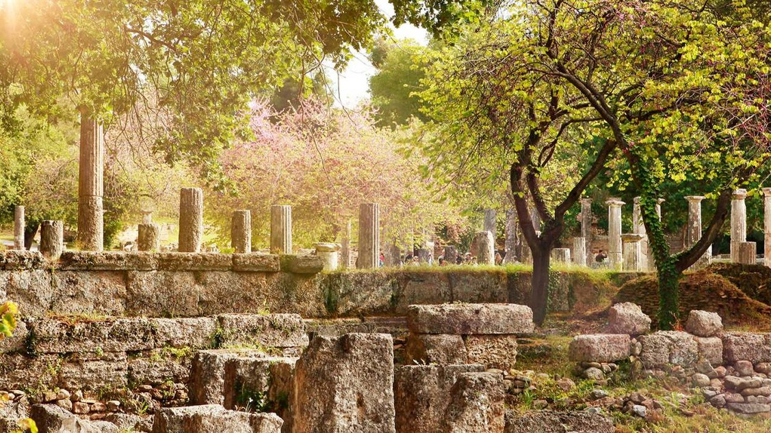
Why Olympia
Where youth sport meets the living heritage of Olympism
• Olympia is the birthplace of the Ancient Olympic Games and one of the most symbolic sporting destinations in the world.
• The Archaeological Site of Olympia is a UNESCO World Heritage Site and remains a global symbol of peace, excellence, unity and respect.
• The tradition of the Olympic Truce reinforces the message of sport as a bridge for friendship and peaceful coexistence.
• The International Olympic Academy and the wider Olympia area give the championship a unique educational and cultural dimension.
From the birthplace of the Olympic Games to the next generation of Muaythai.
IFMA Youth World Championships 2026 | Olympia, Greece
2

Slide 3
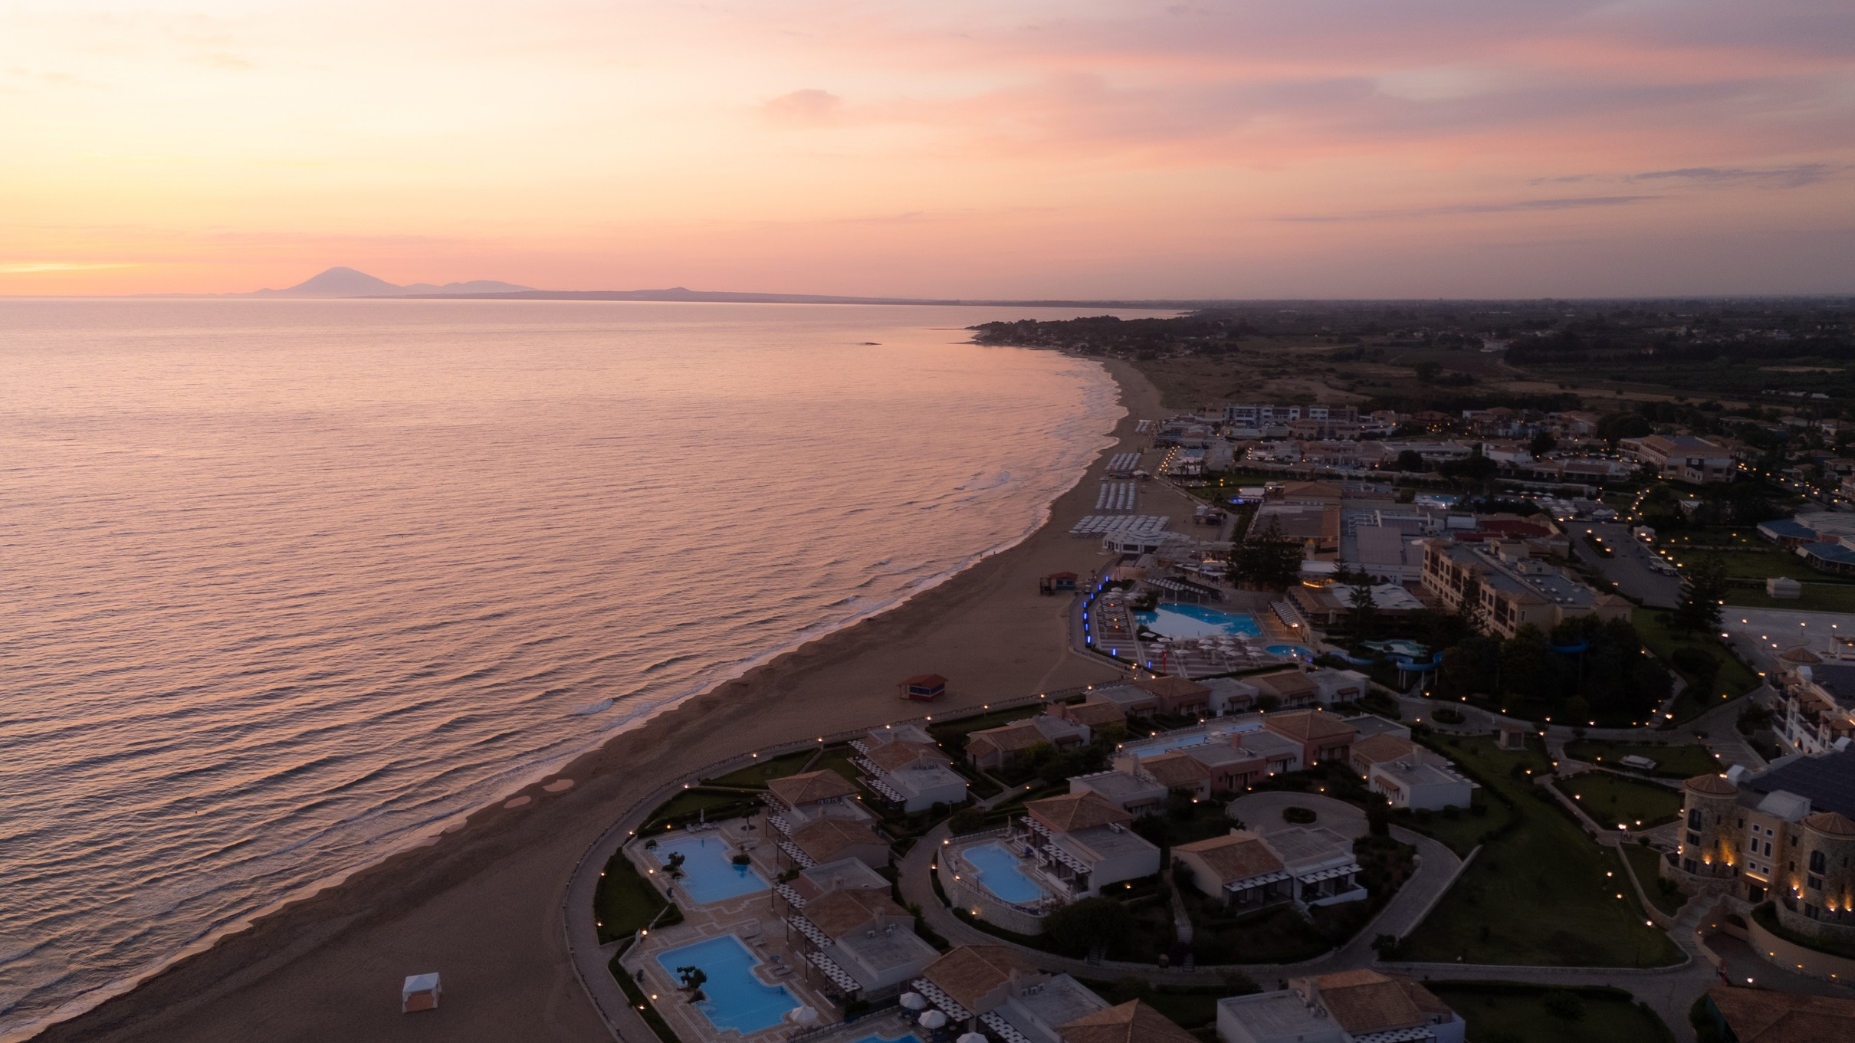
Arrival in Greece & Transfers
A simple international gateway and a fully organised arrival experience
ATHENS INTERNATIONAL AIRPORT (ATH)
3.5–4 HOURS
Organised coach transfers through the Greek countryside to Olympia
Official transfers are included on the scheduled arrival and departure days.
• Main international gateway: Athens International Airport “Eleftherios Venizelos” (ATH)
• Once teams arrive at the resort, no daily hotel-to-competition transport is required.
IFMA Youth World Championships 2026 | Olympia, Greece
3

Slide 4

The Championship Village
Aldemar Olympian Village — the main official hotel and central event hub
5★
~60 acres
Beachfront resort
Landscaped resort grounds
Full board
Ionian Sea
Breakfast, lunch & dinner
Skafidia beachfront setting
Our aim is to accommodate participating delegations within the same resort environment, creating a true Championship Village that simplifies logistics and strengthens the sense of community.
Rooms, suites, apartments and bungalows, together with extensive leisure and meeting facilities.
IFMA Youth World Championships 2026 | Olympia, Greece
4

Slide 5
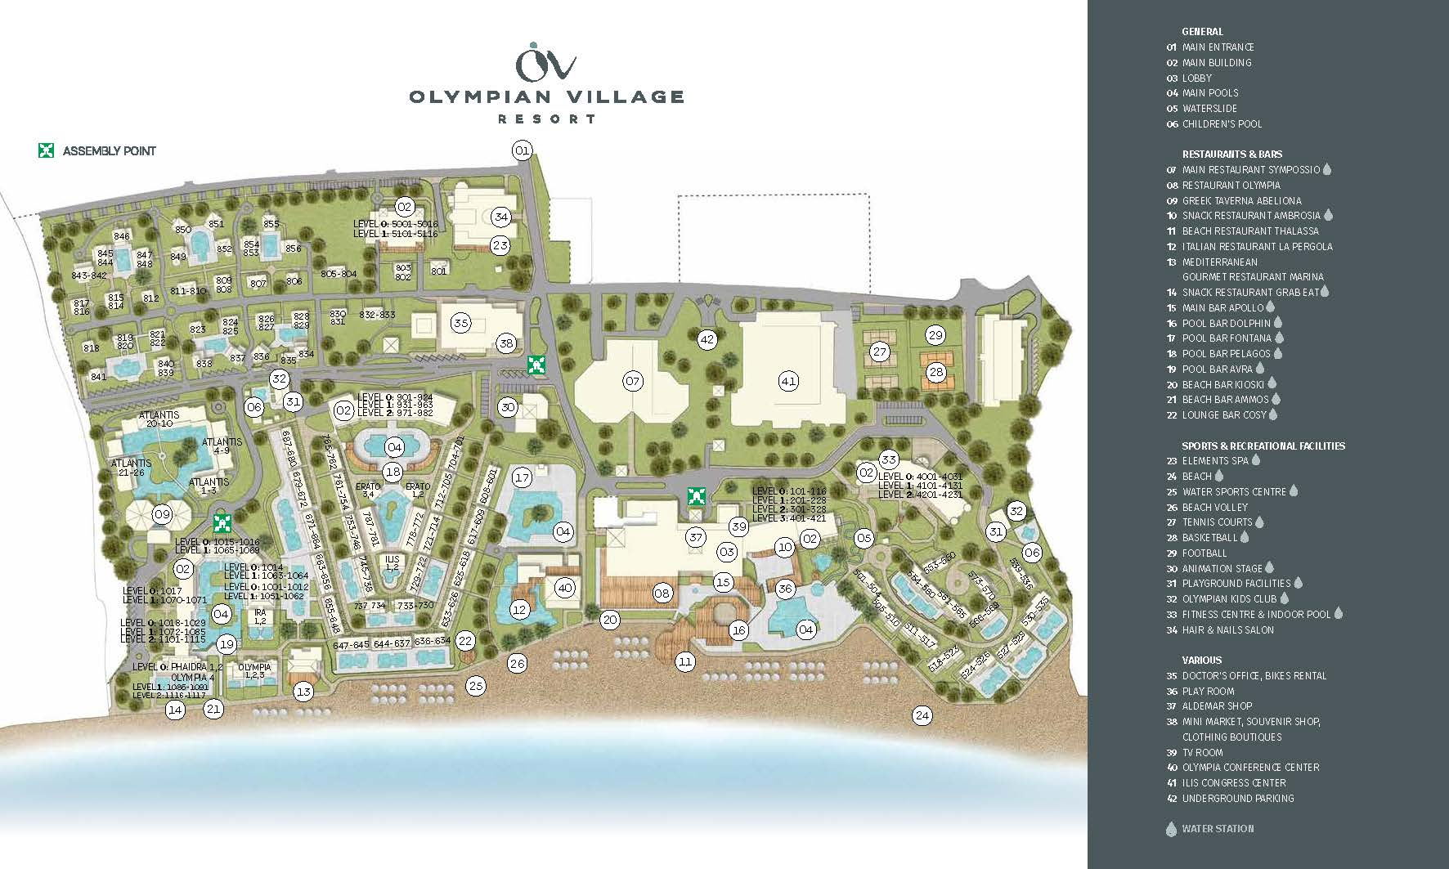
A Fully Integrated Championship Venue
Competition, accommodation, meals and most official activities in one environment
The operational
advantage
ILIS CONGRESS CENTER
• Ilis Congress Center serves as the main competition arena.
• Meals, accommodation and meeting spaces remain within the resort.
• Accreditation and participant services can be centralised on site.
• Only selected official activities outside the resort require LOC transport.
No daily hotel-to-venue transport
IFMA Youth World Championships 2026 | Olympia, Greece
5

Slide 6
Participant Services & Safety
A practical championship environment designed around youth athletes
ACCREDITATION
MEALS
TRAINING
MEDICAL
On-site accreditation and registration support within the championship hub.
Full-board service with daily breakfast, lunch and dinner, including Greek and international cuisine.
Training areas and resort fitness facilities available within the championship environment.
On-site medical teams and ambulance coverage during competition, 24-hour hotel medical coordination, and General Hospital of Ilia approximately 15 minutes away.
A safe, inspiring and fully integrated championship environment.
IFMA Youth World Championships 2026 | Olympia, Greece
6

Slide 7
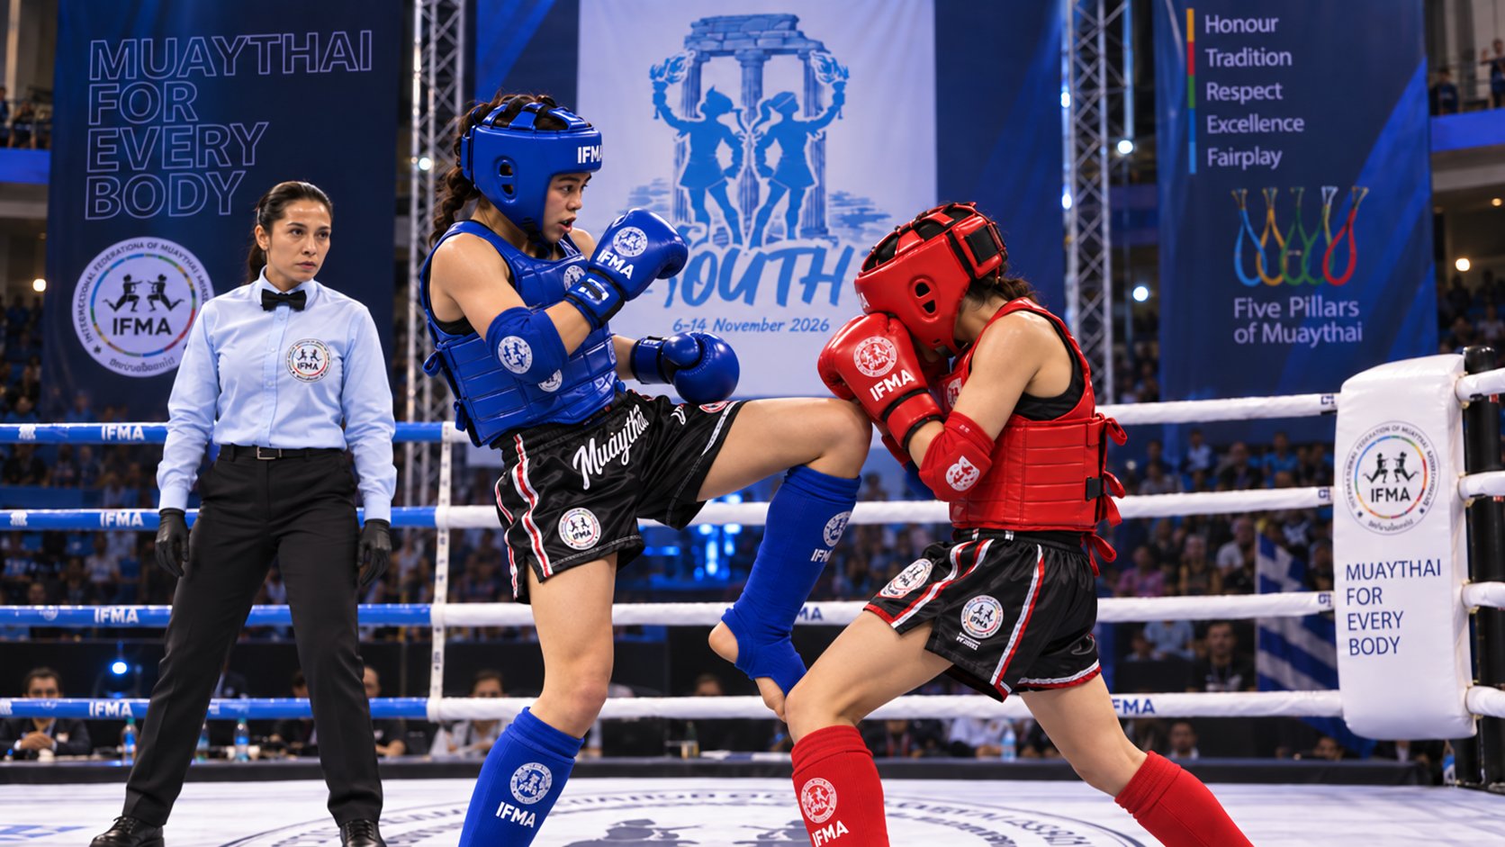
Event Framework
Key dates, competition flow and November conditions
• Official event period: 6–16 November 2026
• Scheduled arrivals: 6–7 November
• Opening Ceremony & competition start: 8 November
• Finals and medal ceremonies: 15 November
• Official departures: 16 November
• Youth championship delivered under IFMA standards, with competition, education and cultural programmes.
Mild Mediterranean November weather
Typically around 18–22°C during the day and 10–13°C in the mornings and evenings.
IFMA Youth World Championships 2026 | Olympia, Greece
7

Slide 8
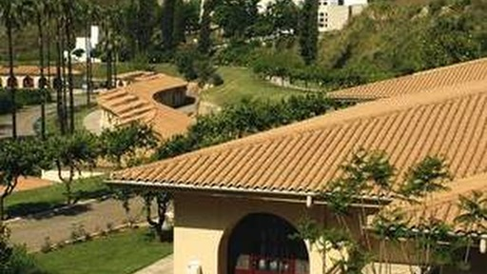
Beyond Competition
Culture, education and connection are part of the championship experience
• Opening Ceremony and official event moments
• Cultural activities, Wai Kru heritage and athlete interaction
• Educational programmes, Athletes Conference and IFMA meetings
• Youth Awards Gala & Goodbye Party, celebrating unity and youth recognition
Olympic legacy + Greek philoxenia + Muaythai culture = a truly distinctive Youth World Championships.
IFMA Youth World Championships 2026 | Olympia, Greece
8

Slide 9
WELCOME TO GREECE
WELCOME TO OLYMPIA
WELCOME TO THE 2026 IFMA YOUTH WORLD CHAMPIONSHIPS
A championship built on hospitality, operational simplicity, youth experience and the timeless spirit of Olympia.
Olympia, Greece | 6–16 November 2026

